Slide 1
Relativity Onsite Presentation: Engine Systems & Test
3/7/2025
Rajan Phadnis

Slide 2
Agenda
About Me
Internship Highlight: Northrop Grumman
Internship Highlight: SpaceX
About PSP and CMS
Upper Plumbing
Sizing (Python and Excel)
System Design
Bang-Bang Manifold Design
Manufacturing
Bang-Bang Test Campaign
Full Vehicle Ops

Slide 3
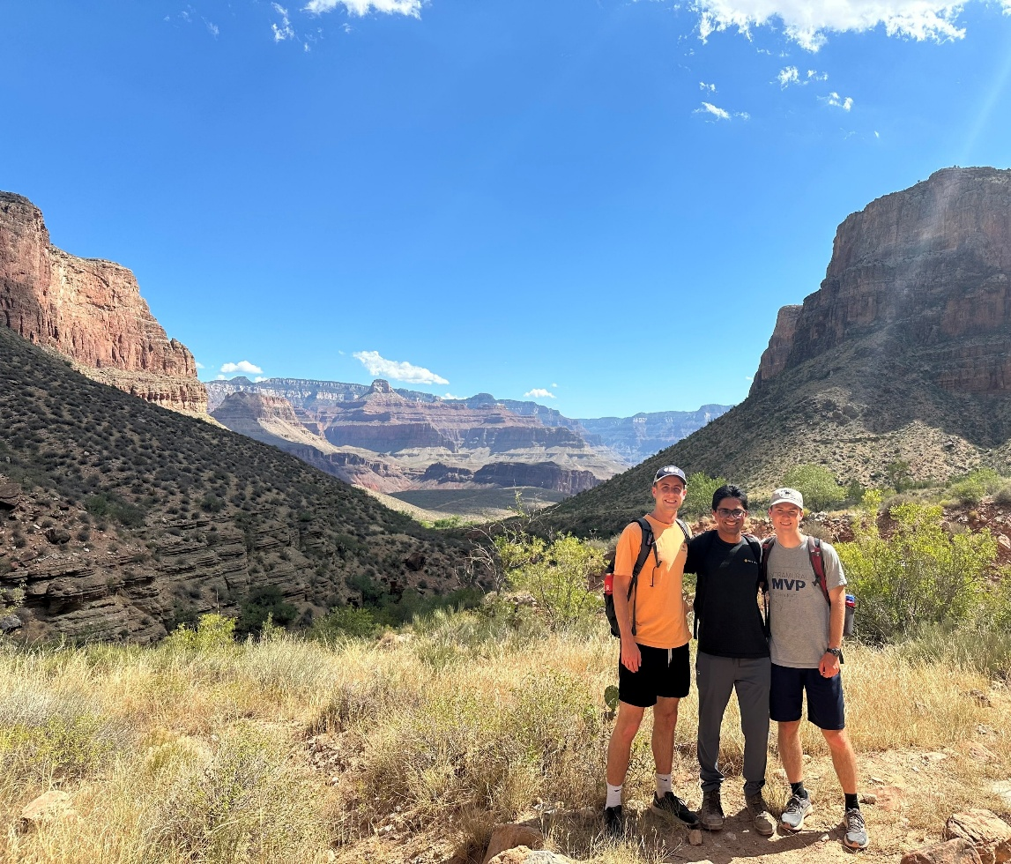
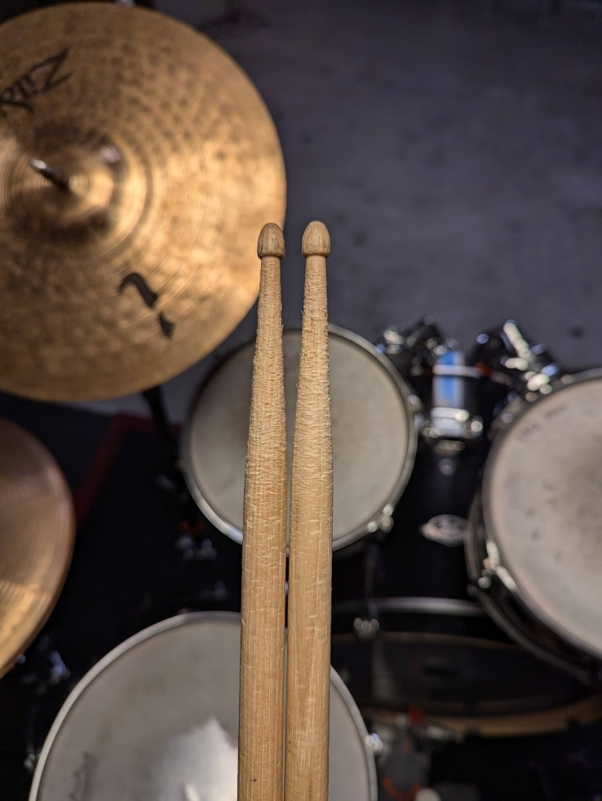
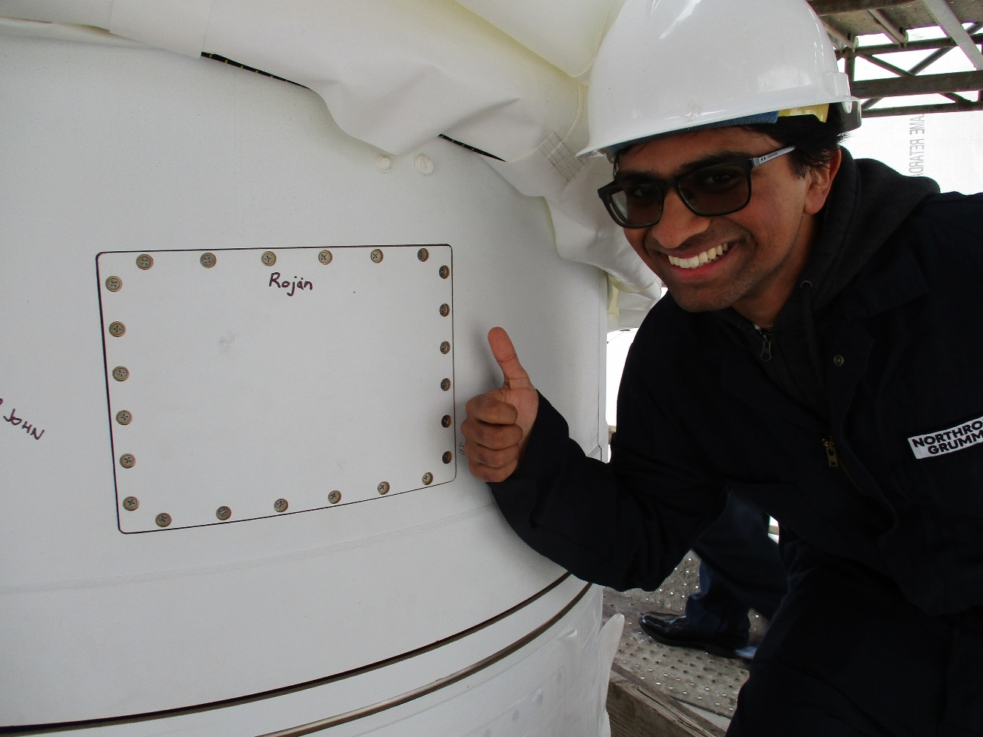
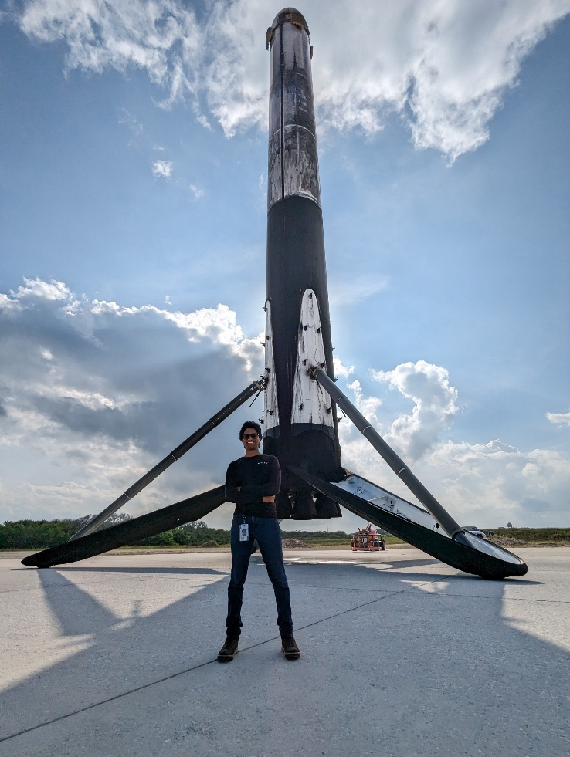
About Me
Born in New York, grew up overseas, moved back to the US for high school
Fluent in French
Visited 60+ countries
Graduated from Purdue in December with a BS in Aeronautical & Astronautical engineering
Part of Purdue Space Program’s Liquids team
2 years of internships:
7 months: T4
4 months: Sentinel
4 months: Antares
5 months: Falcon
4 months: Raptor
@ Northrop Grumman
@ SpaceX

Slide 4
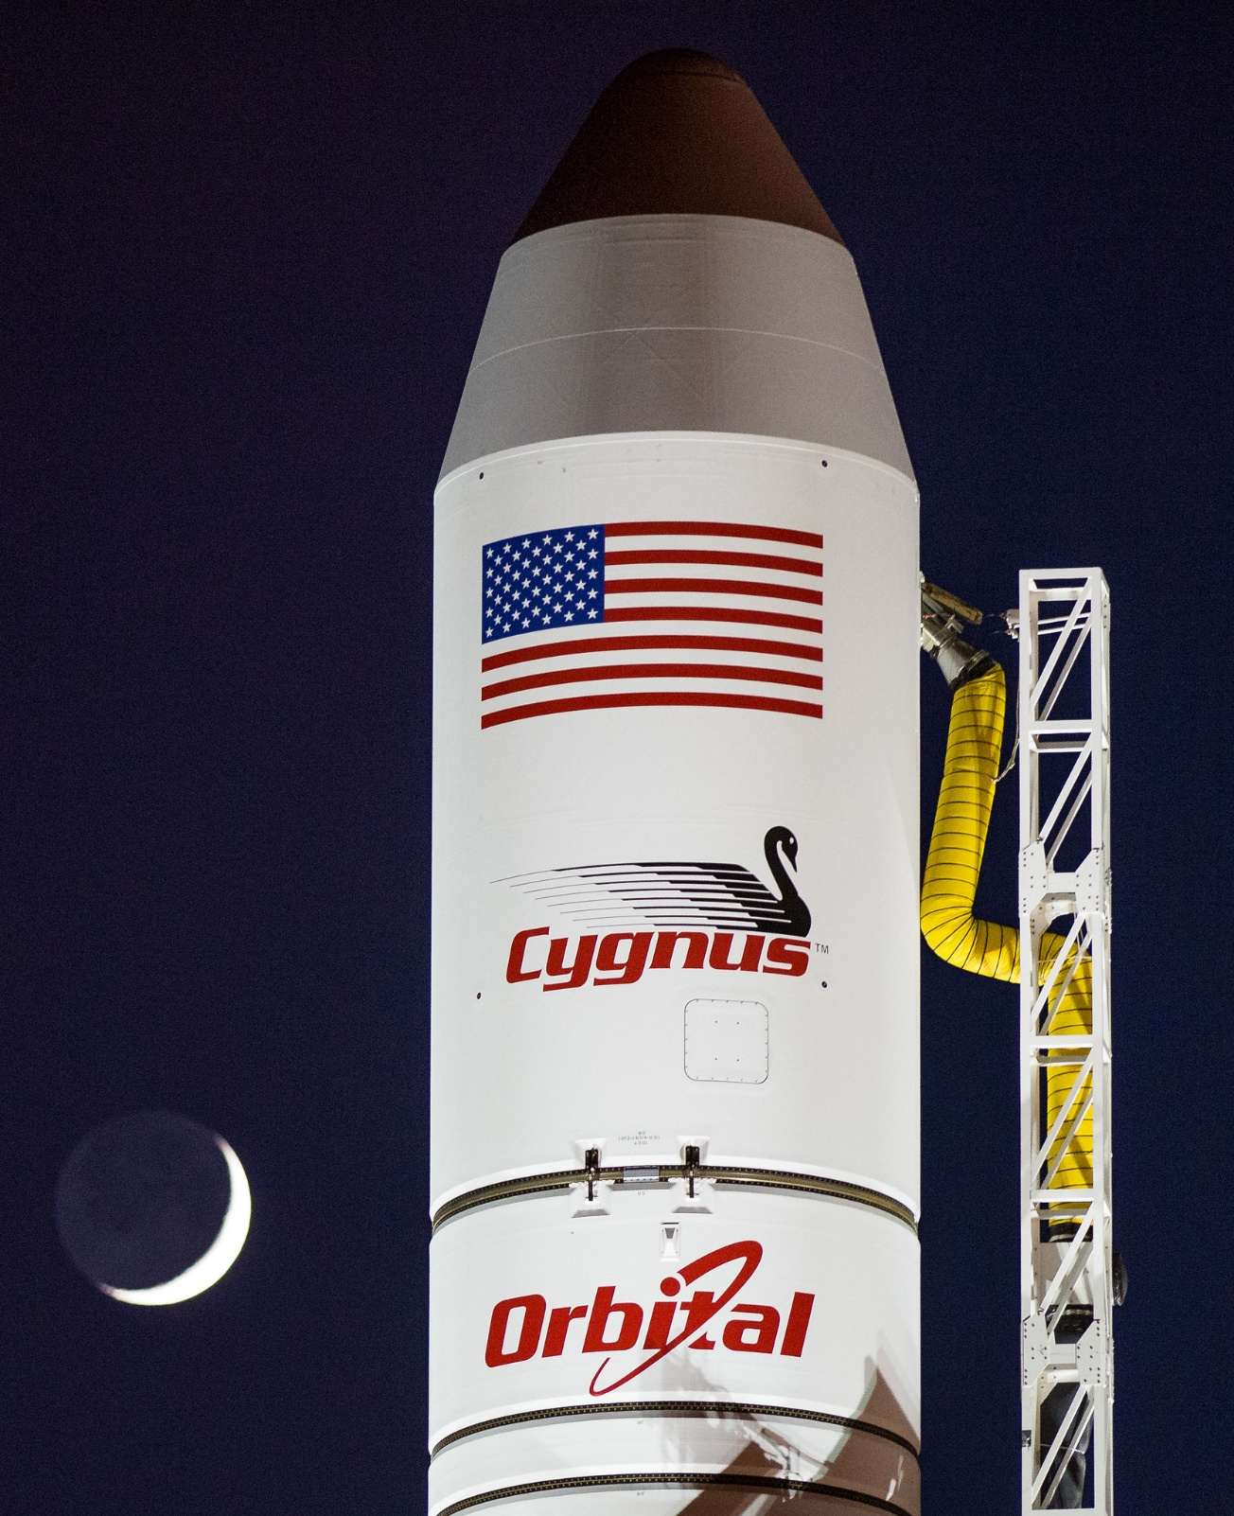
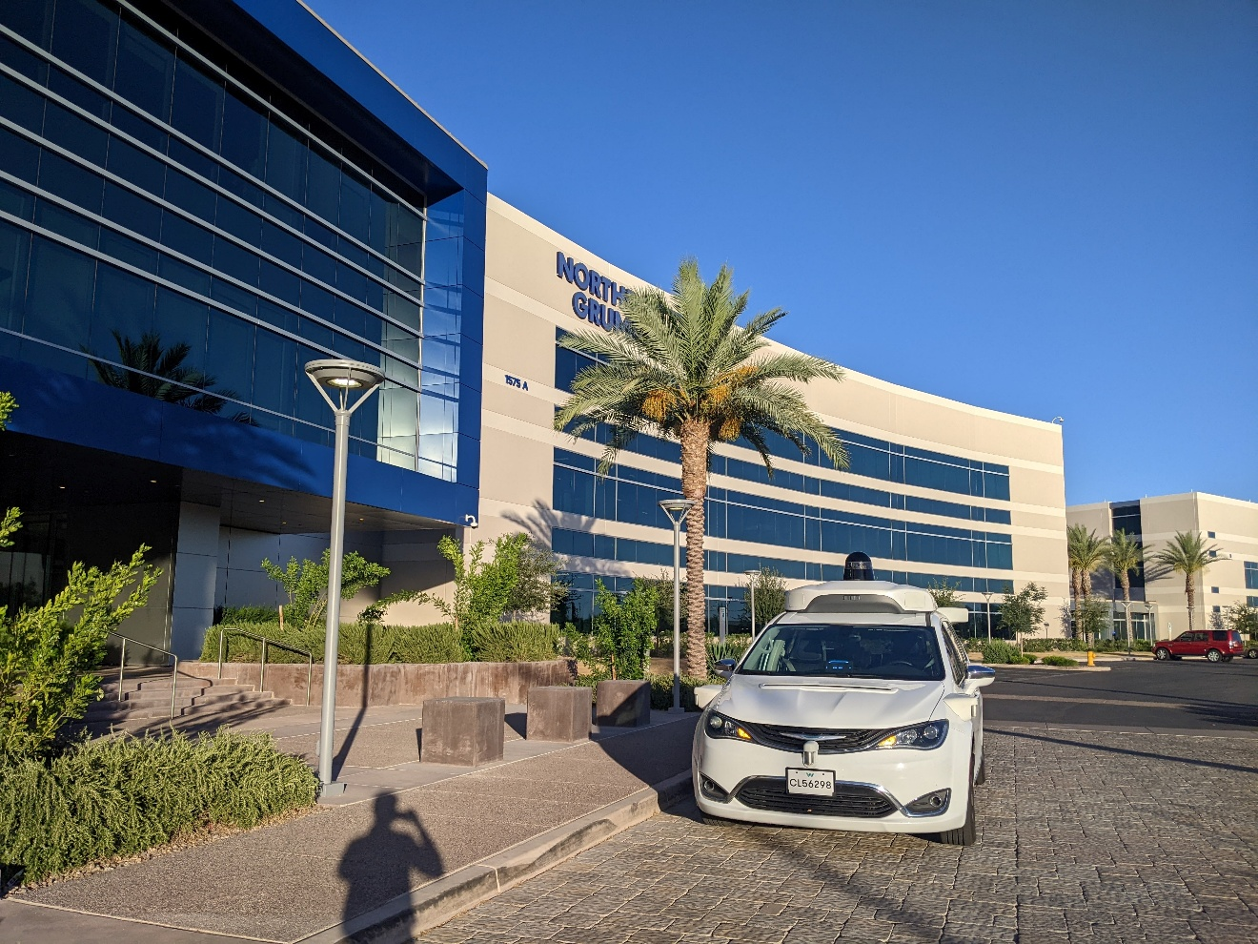

Internship Highlights: Northrop Grumman
Designed a mating ring for Cygnus to Antares, Falcon 9, MLV (Firefly)
Sized Sentinel’s TVC system
A bunch of propulsion system optimizations for a classified program
Designed vehicle conditioning GSE for a classified program

Slide 5
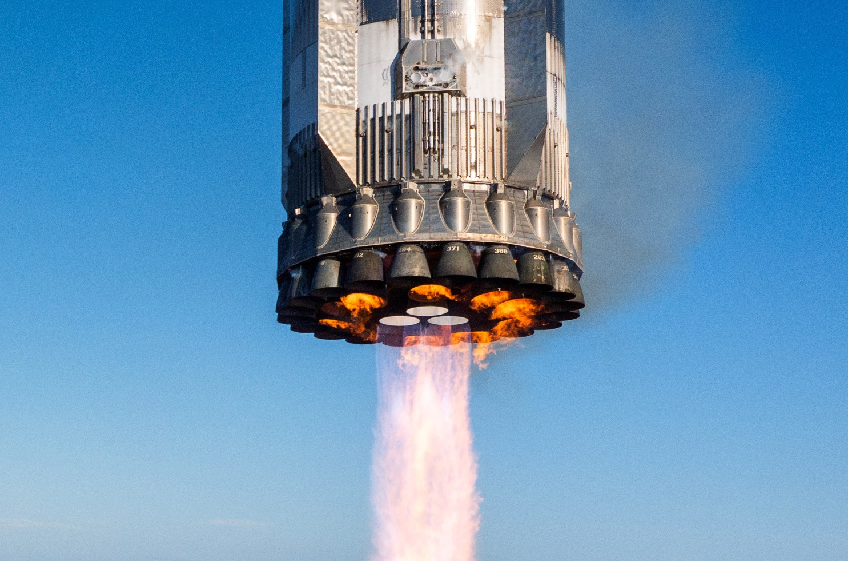
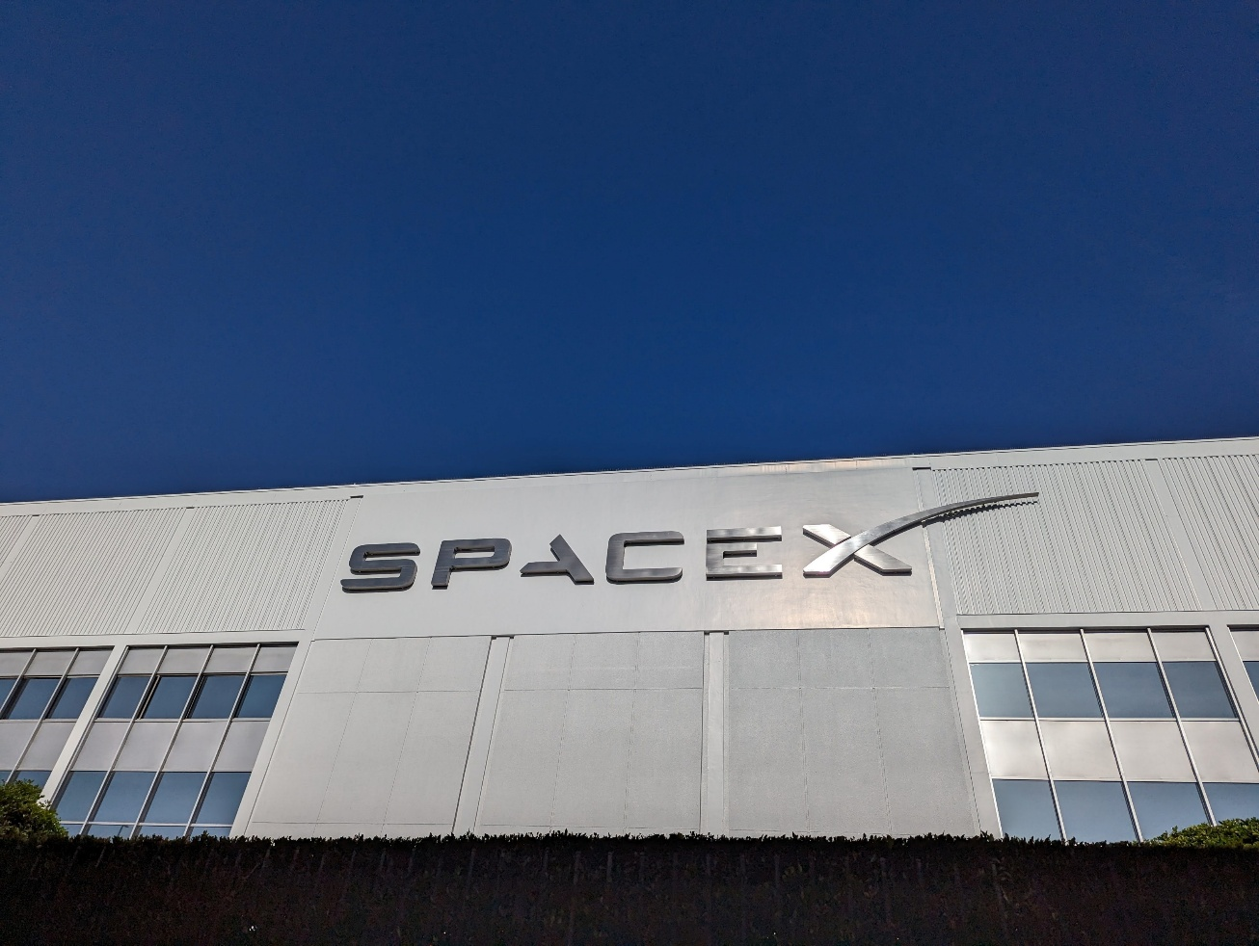
Internship Highlights: SpaceX
Raptor
Falcon
Owned nozzle heating for Flight 5 (catch!) landing burn and hot staging startup development
Startup was a VERY high risk, so scope creep and pressure was high
Cut QD setup time by 10%+ via automation
Deleted 400+ engineering labour hours via autosequences
Automated away most (if not all) nominal checkout data reviews
Notes:
Booster landing photo: Credit: SpaceX on X: https://x.com/SpaceX/status/1880332005084471404/photo/4

Slide 6
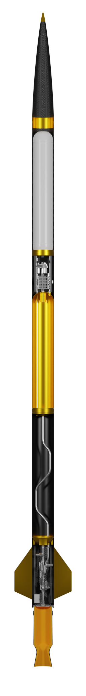
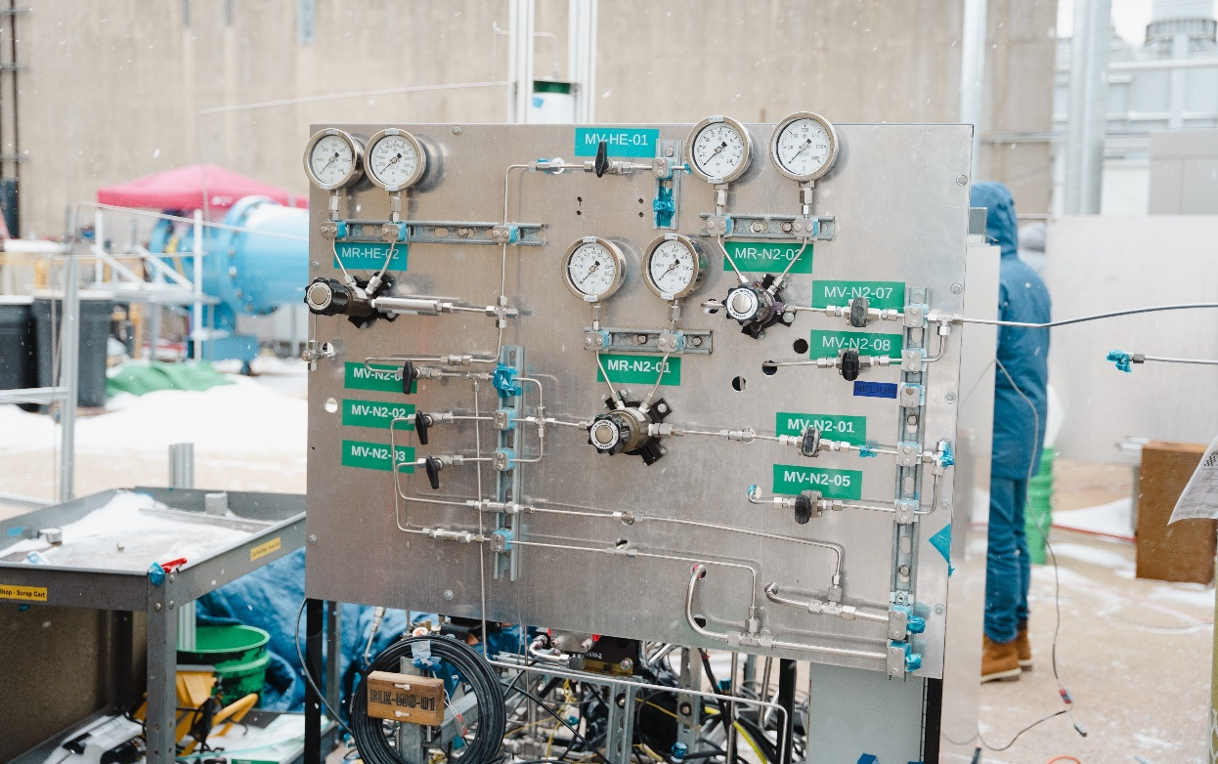
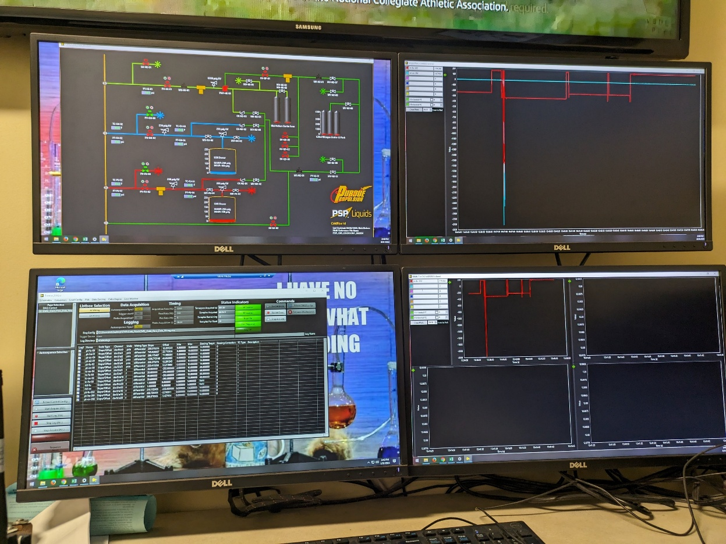
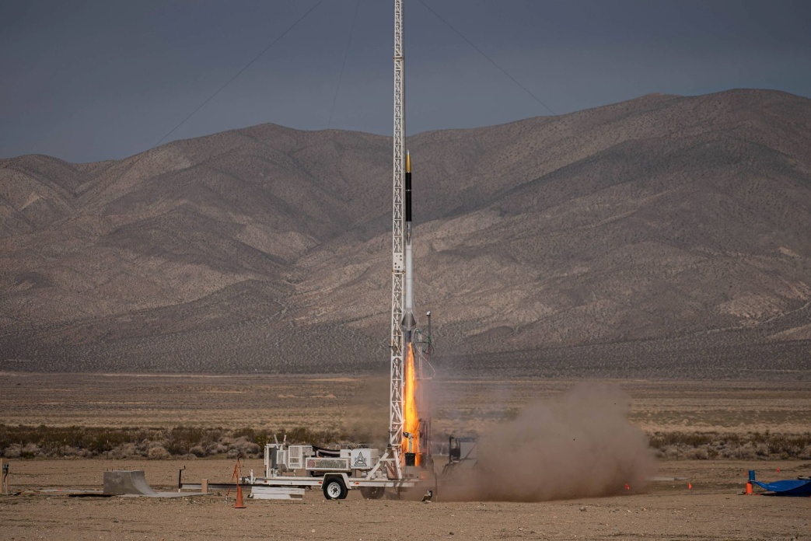
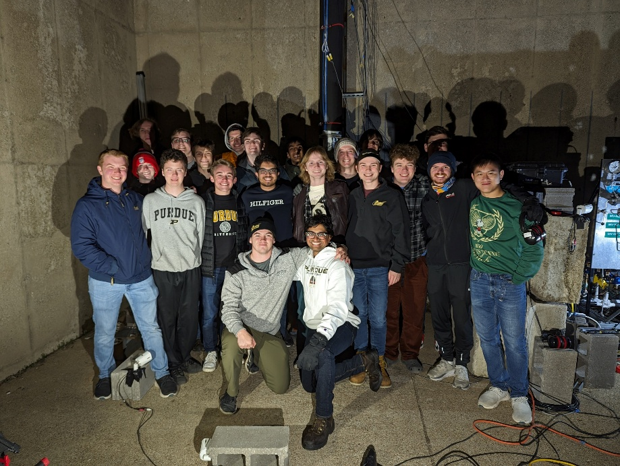
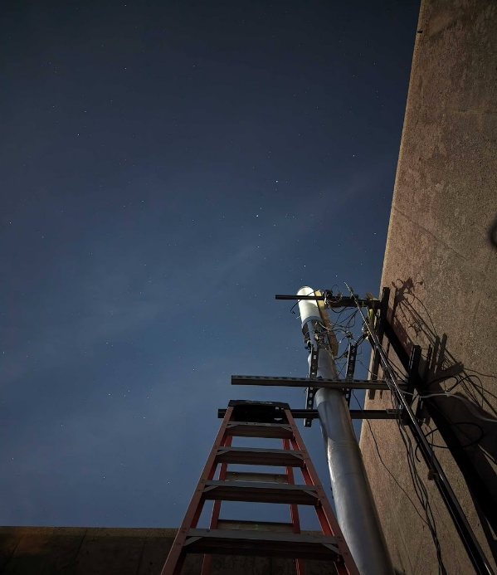
Purdue Space Program - Liquids
Purdue’s student-run liquid rocketry team
Launch of CraterMaker Special…soon
900lbf engine, targeting 40,000ft apogee
Methalox vehicle + helium press system
Lower
Plumbing
Upper Plumbing
Nosecone/Recovery
Engine
Methane Tank
LOx Tank
Helium COPV

Slide 7
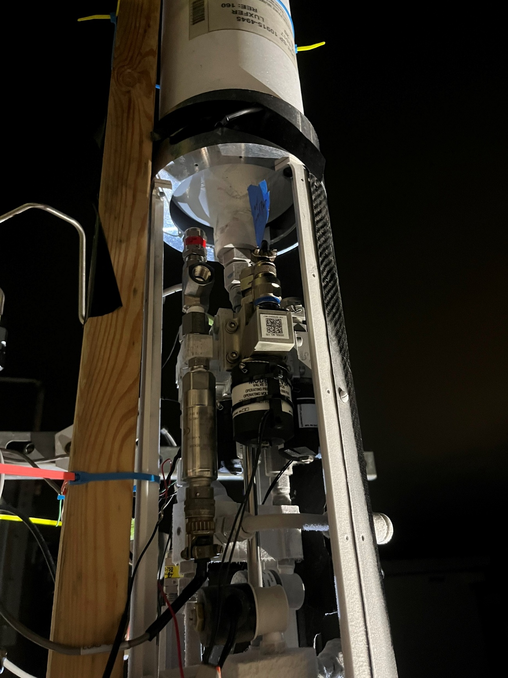
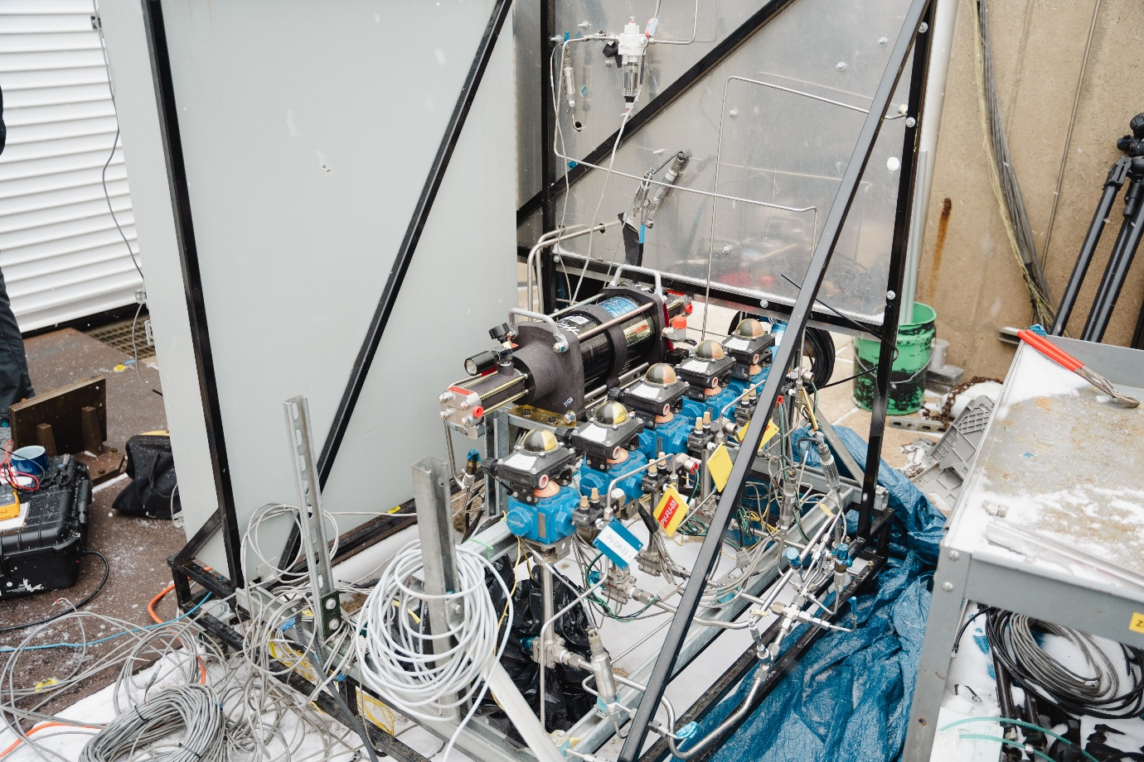
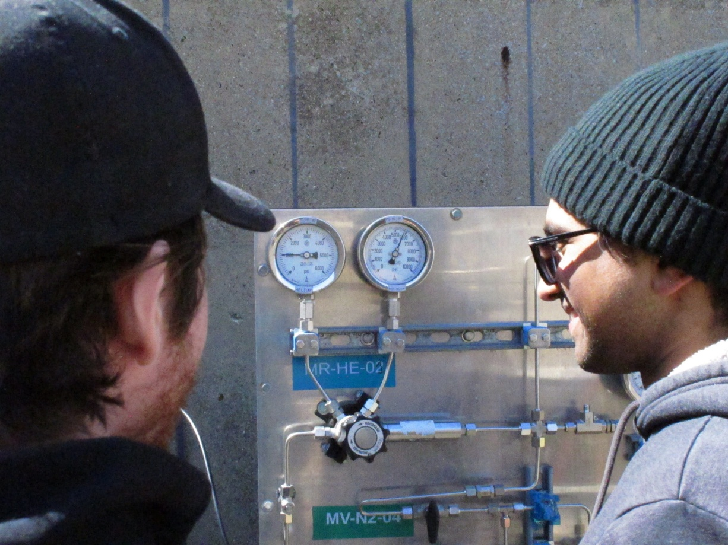
CMS & Me: Upper Plumbing & GSE
Upper Plumbing:
Sizing, design and simulation
Manufacturing, qualification and test
Avionics packaging and bang-bang integration
GSE buildup to support test and flight ops (fluids + daq)
Data visualization platform

Slide 8
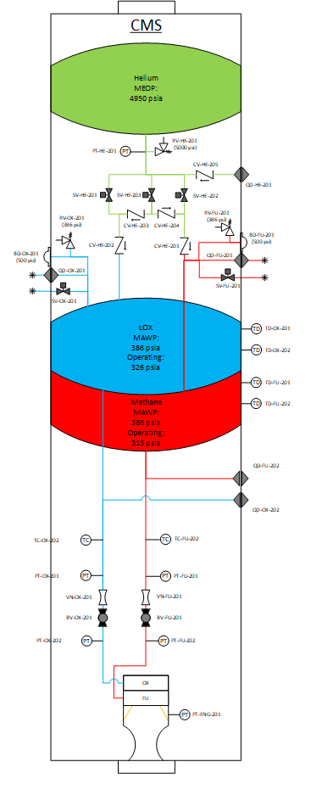
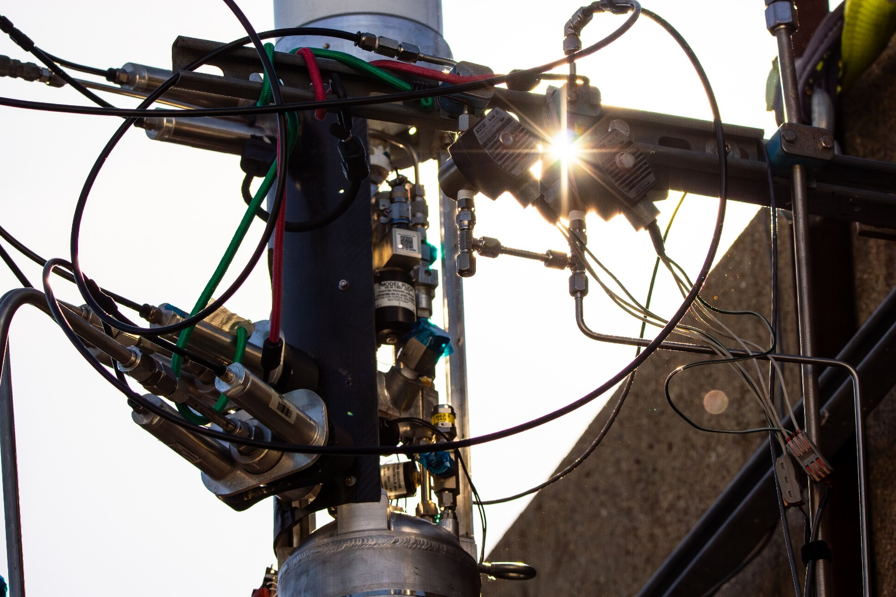
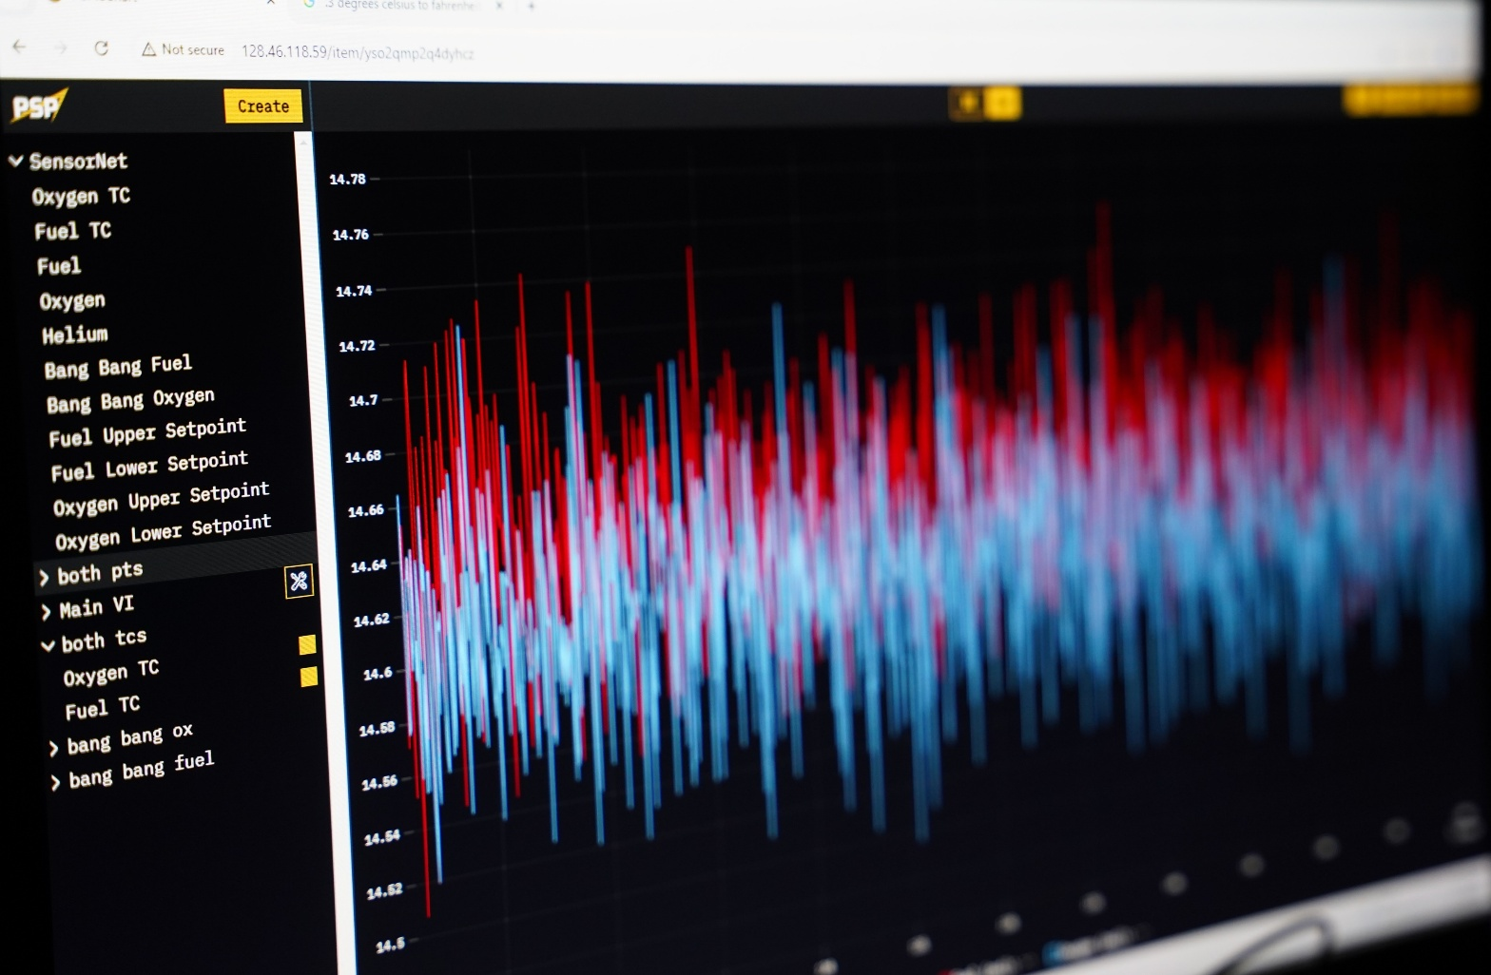
Upper Plumbing Goals
Press the tanks to flight pressures (LNG: 315psia, Lox: 326psia) and keep them within +/- 15psi
Fill the vehicle’s commodities tank and press to 4950psia
Handle nominal and most emergency vent scenarios

Slide 9
Overview
Sizing
Python & Excel
System Design
Fluids System Design
Bang-Bang Manifold
Manufacturing
Subsystem Test Campaign
Vehicle Test Campaign

Slide 10
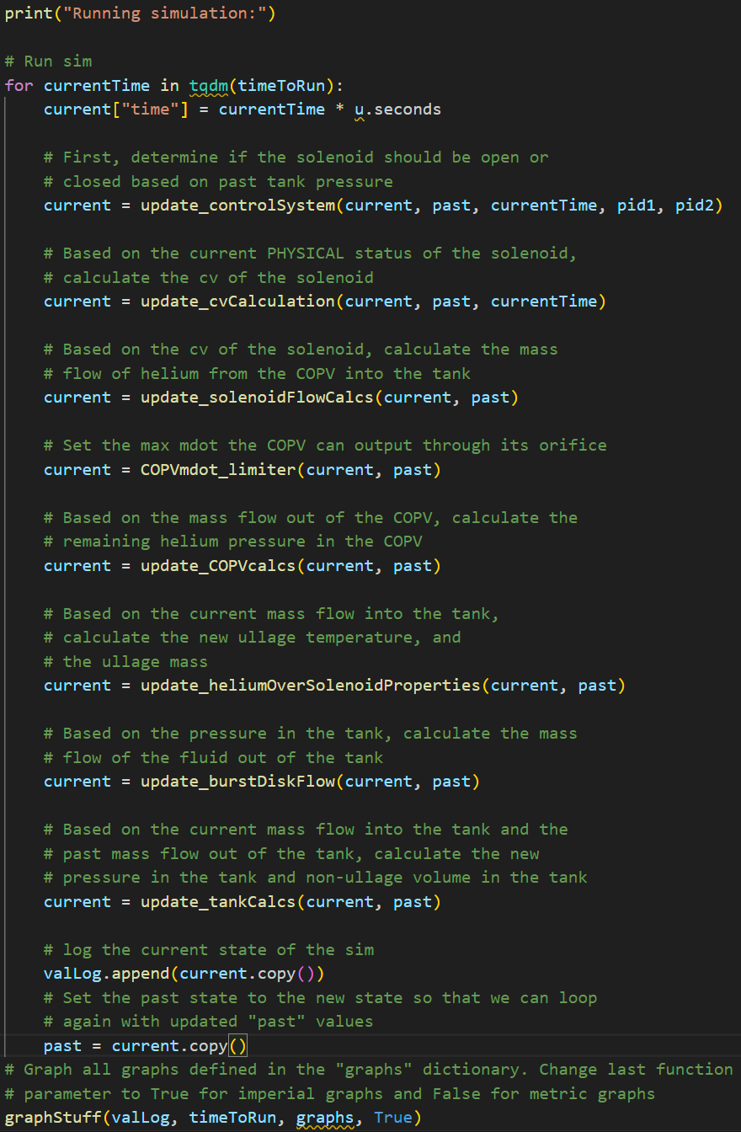
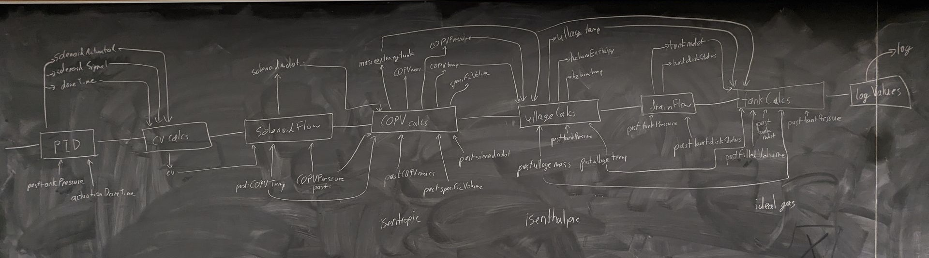
Sizing Sim: Python
Goal was to create a model that could:
Size orifices, COPV, line sizes, and pressure spikes
Form a baseline for test data comparison
Execute on a faster-than-realtime basis
Iterative time-based approach, largely gated by coolprop latency
COPV end state determined isentropically
Expansion across bang-bang is isenthalpic (Joule-Thomson effect applies) – lookup enthalpies via knowns and coolprop
Had a lot of issues with Coolprop and units – paused work to get basic sizing done in Excel instead

Slide 11
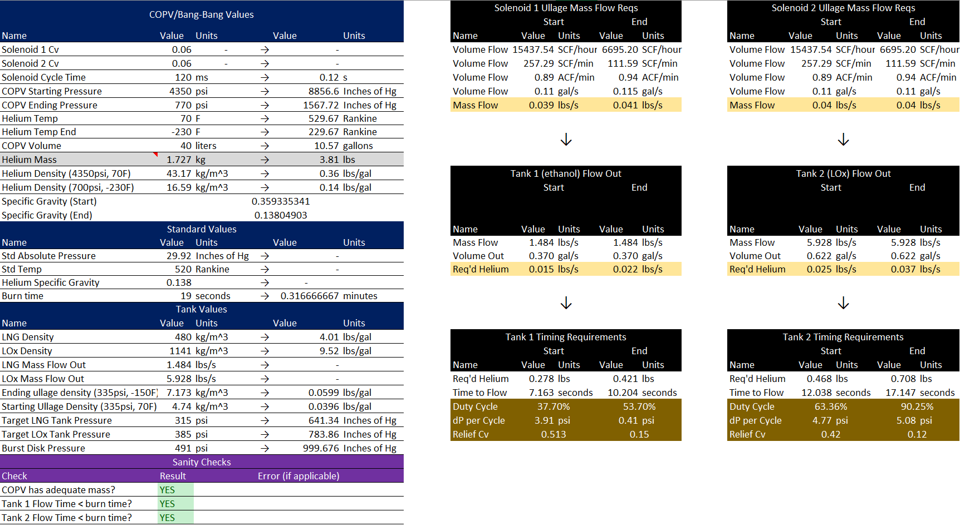
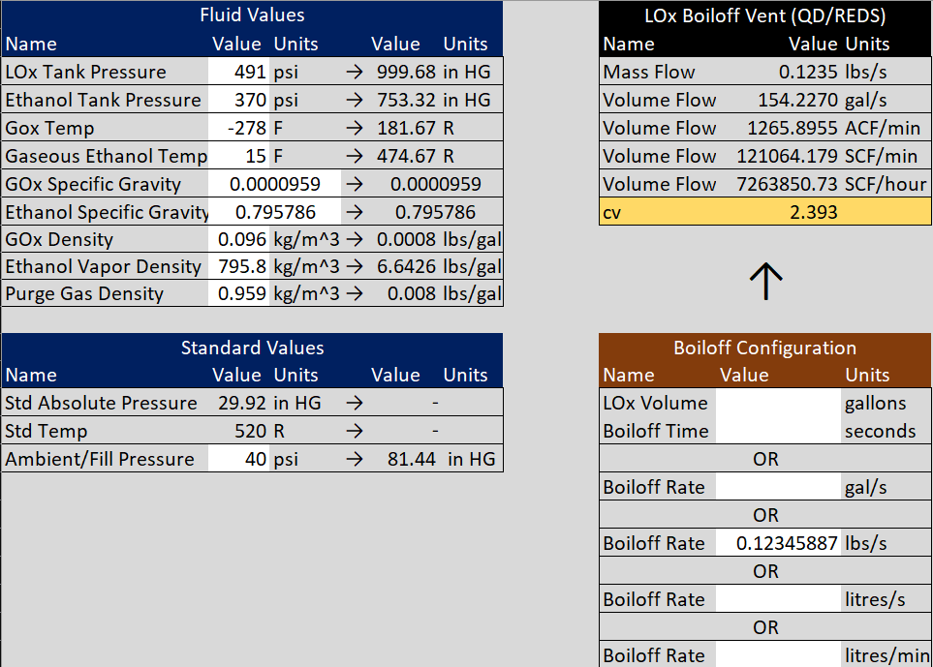
Sizing Sim: Back to Basics
Modeled start and end conditions as if they were the steady-state conditions
Sized solenoids to hit within 25%-75% duty cycle to avoid high pressure spikes and loss of press authority
COPV end pressure was 2x prop tank MEOP to ensure flow remain choked across bang-bang
Assumed thermal dwell from COPV loading diminished over time – COPV starts at 70F
Gating vent config was lox boiloff + emergency depress, so switch to methane didn’t change gating vent config
Used these calculators to find:
Solenoid Cv
Max allowable cycle time
Pressure spike
Min relief/burst disk/QD Cv
Req’d COPV size and prepress
System mass flows
LNG: 38%→54%
LOx: 64% → 90%

Slide 12
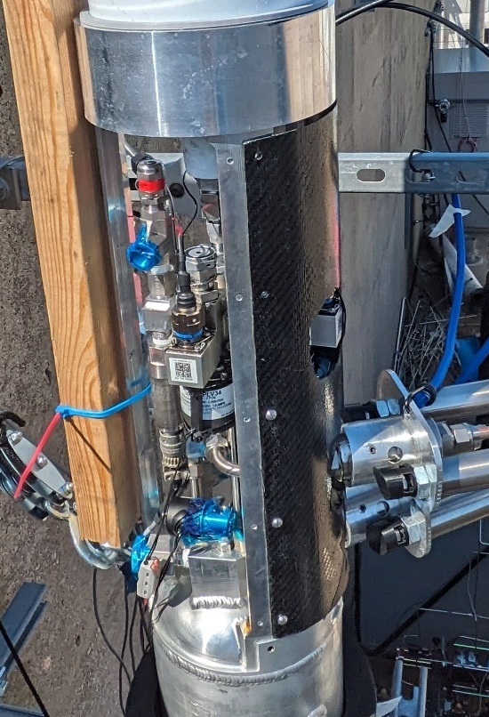
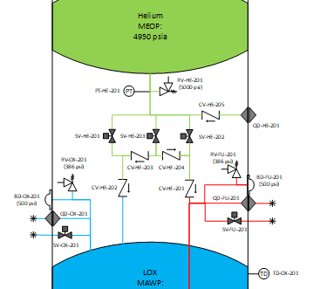
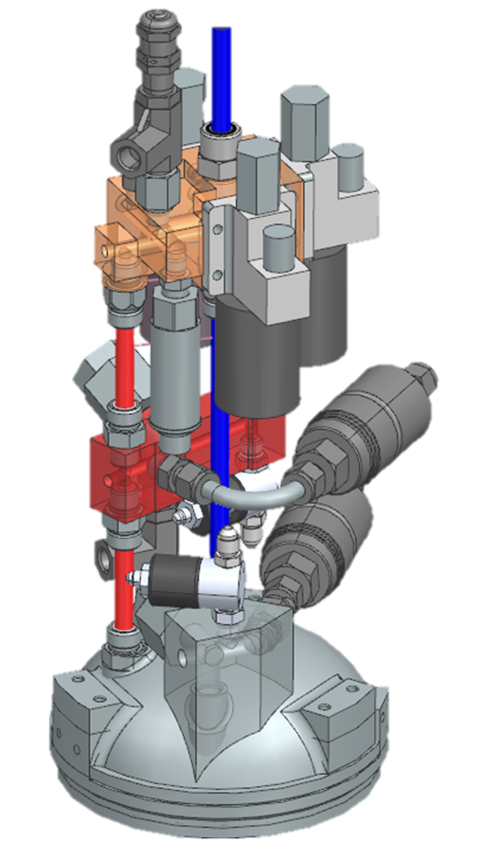
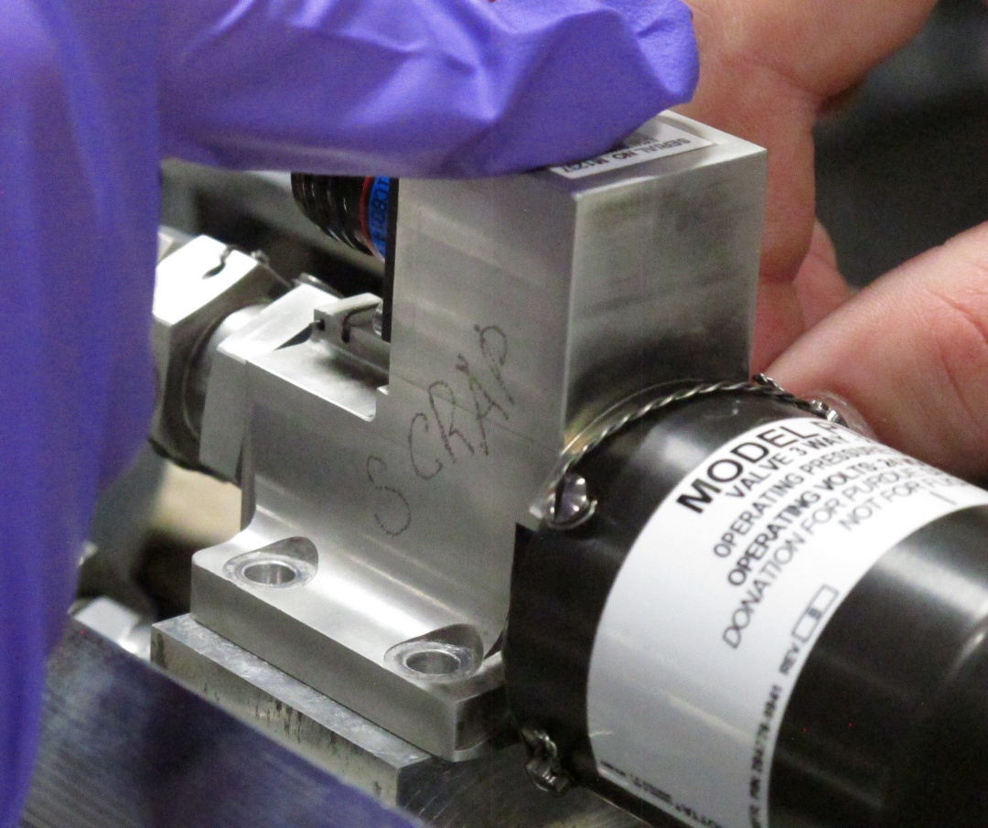
System Design
Constrained by space, driven by top-level vehicle sizing
Consolidated into three manifolds:
Vent manifold (one per tank due to LOx feedline positioning)
Press/fill manifold milled from a single block of Al6061
Vent manifold distinct from press manifold
Worked around accessibility and tool constraints
Removed instrumentation I originally thought we needed

Slide 13
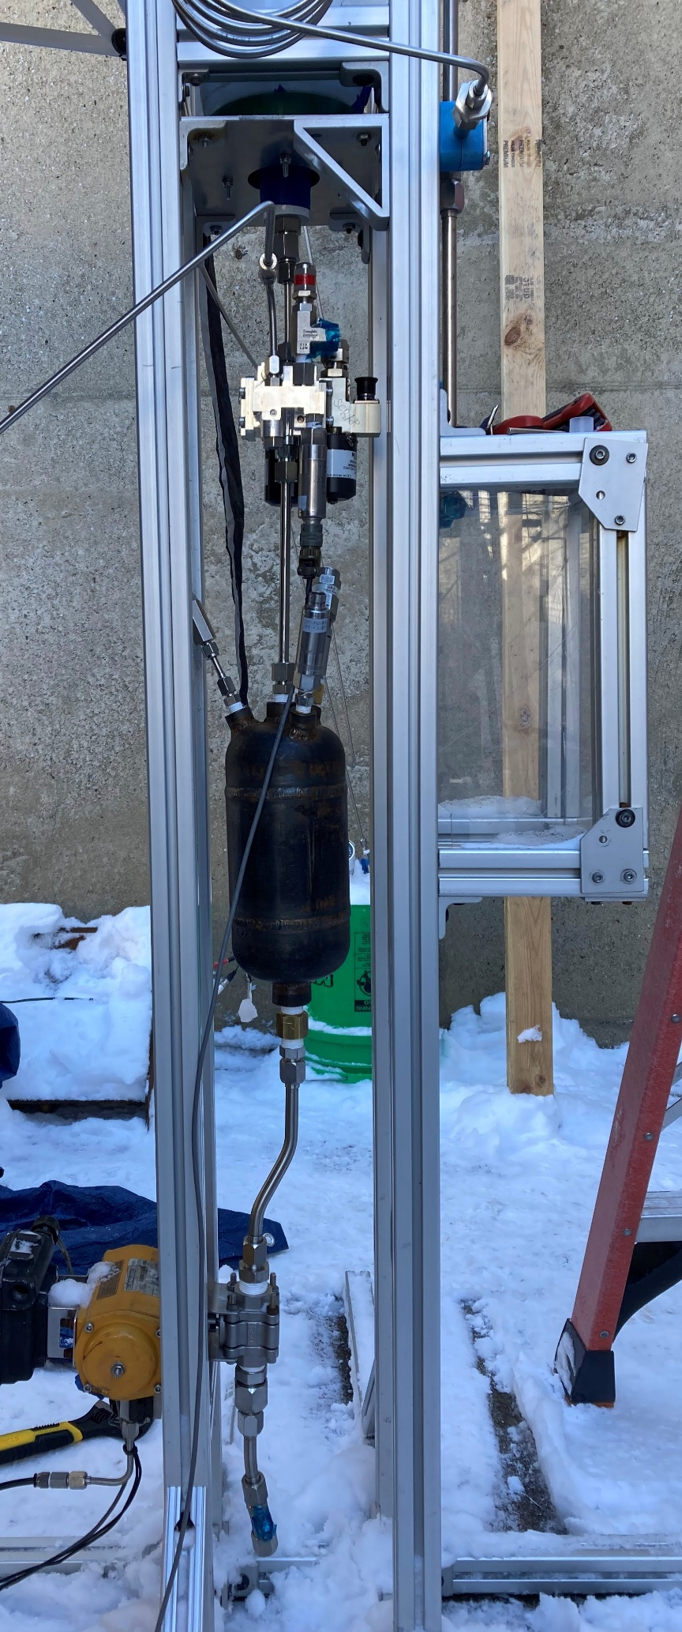

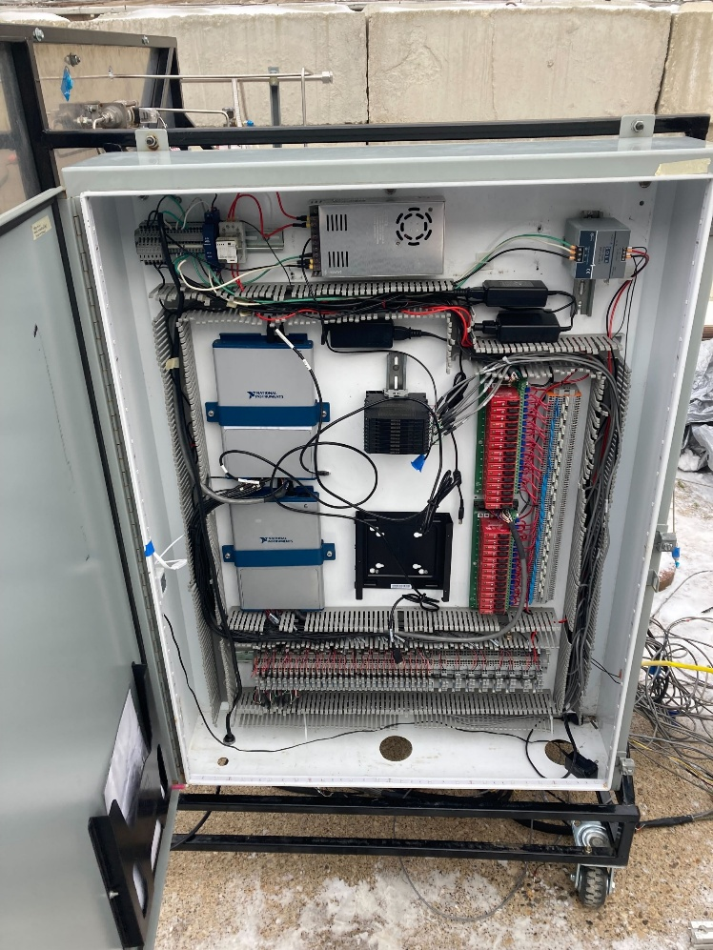
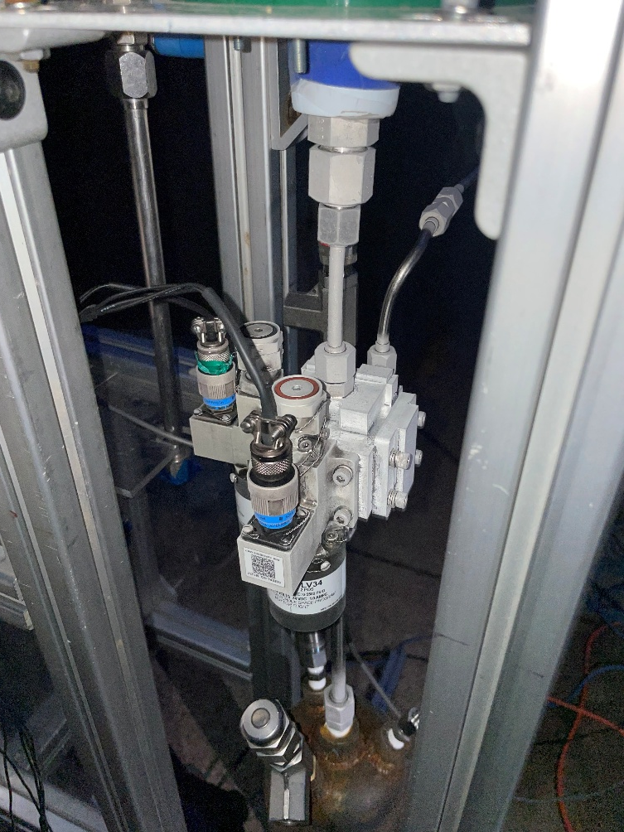
Bang-Bang Test Campaign
Goals:
Validate solenoids (flow rate, cycle time, thermal capability)
Stand up GSE sled (boost pump activation + general activation), labview and Avi for the first time
Write procedures that would be adapted into full vehicle ops
Gain experience with cryo ops and get everyone excited about “hardware mode”
2x Short-duration, low-pressure GN2 test
2x Full-duration, 6ksi GN2 test
Notes:
Built a test tank out of sch40 steel pipe + endcaps (MEOP 318psi, orifice: 0.138”)

Slide 14
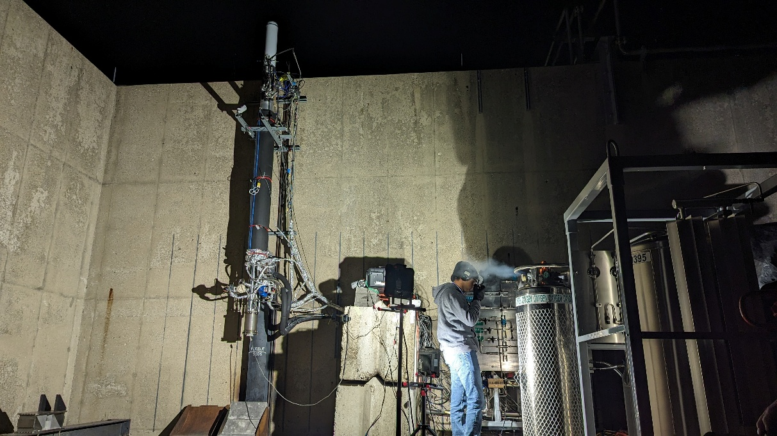
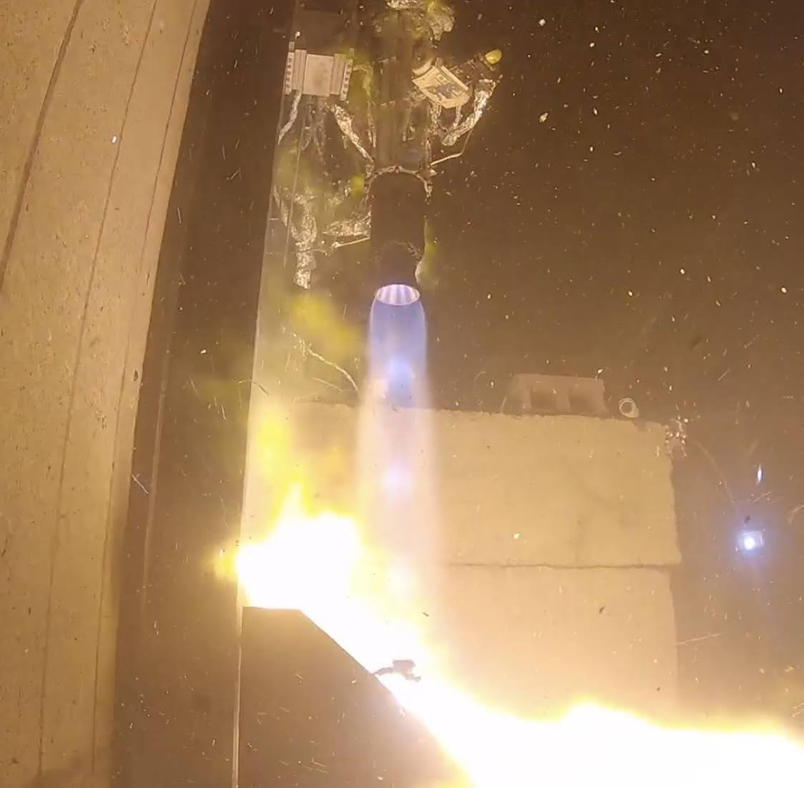
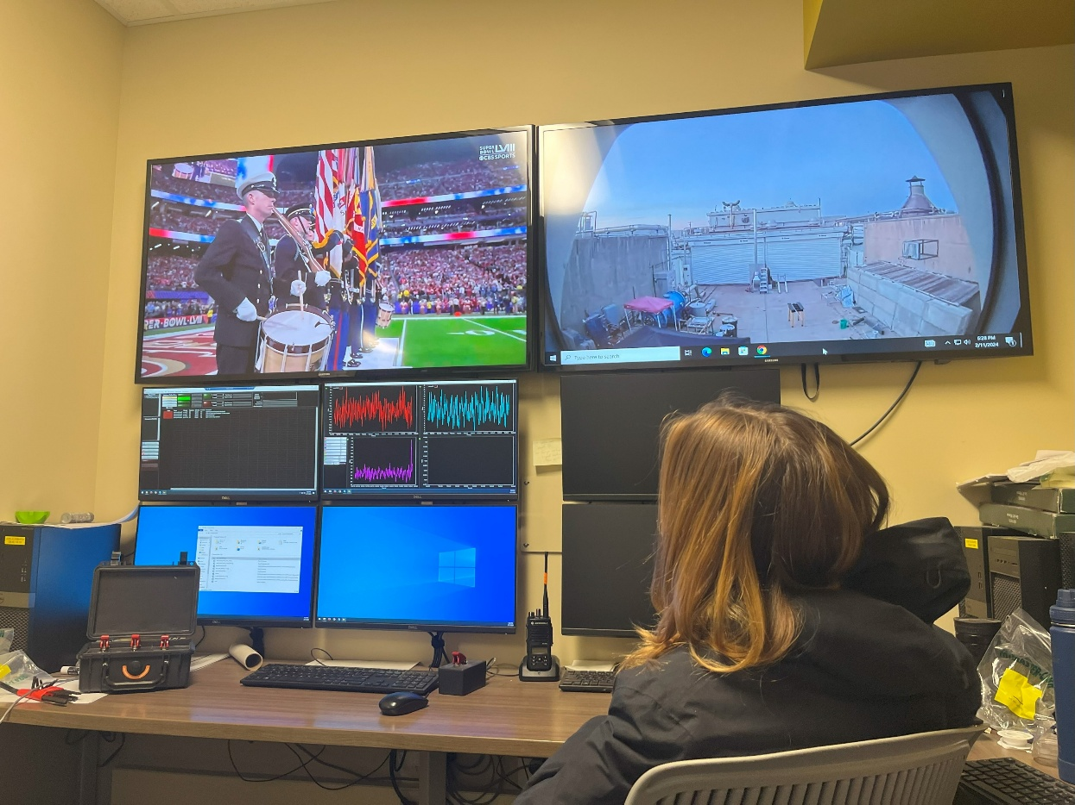
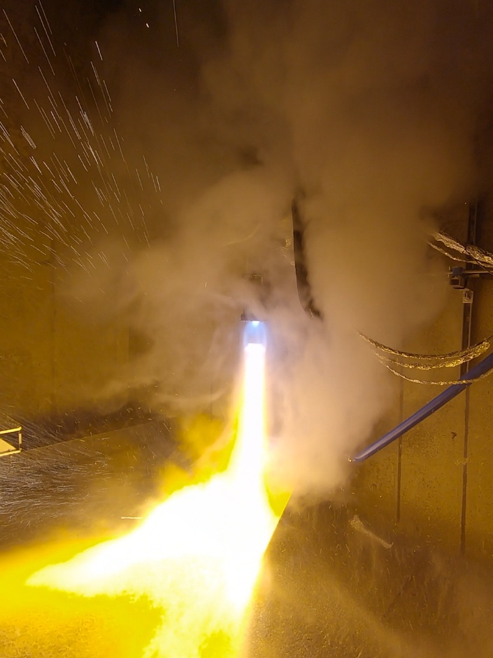
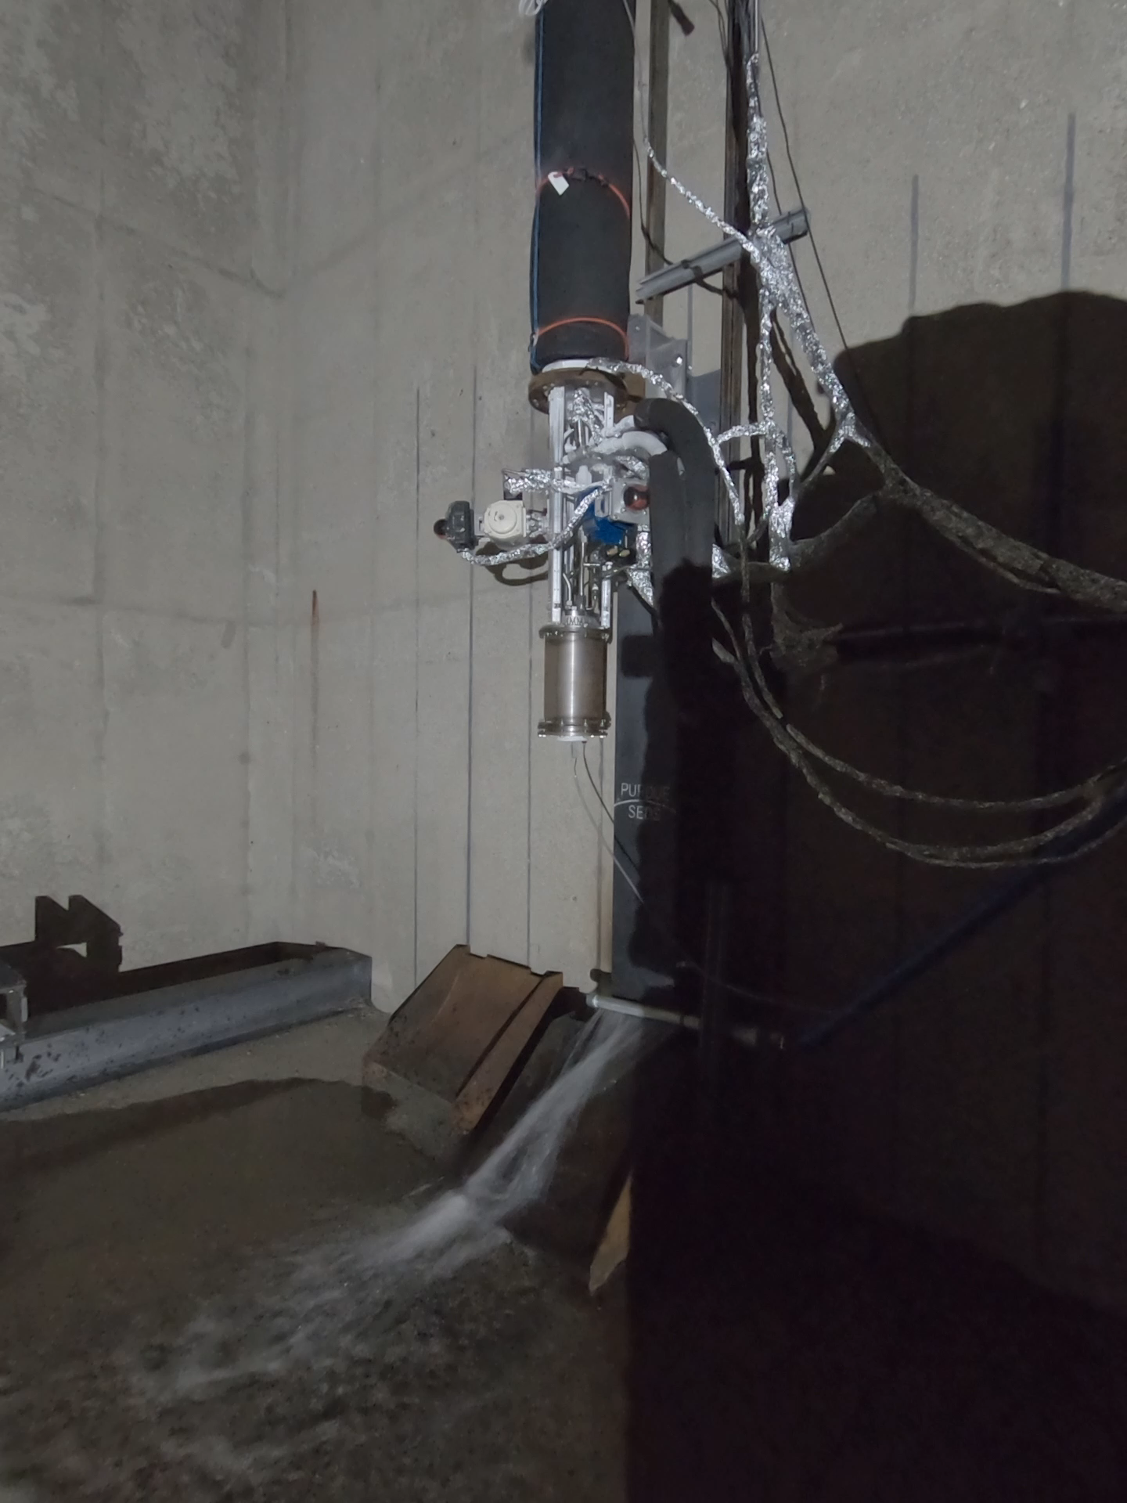
Integrated Vehicle Ops
Performed as a Test Operator and led portions of data reviews
Tests completed:
2x Cold flows
2x hotfires (hotfire 2 aborted after losing runline PTs due to uncontrolled flame)
First full vehicle tests with actual procedures
What to do when something goes wrong
Triple the timeline and accept some leaks
Clear comms and overcommunication saves time and commodities
Notes:
Ox press valve saw degraded performance (maybe ice?) on second hotfire (full duration). Seemed to fail shut and developed longer cycle times than expected.

Slide 15
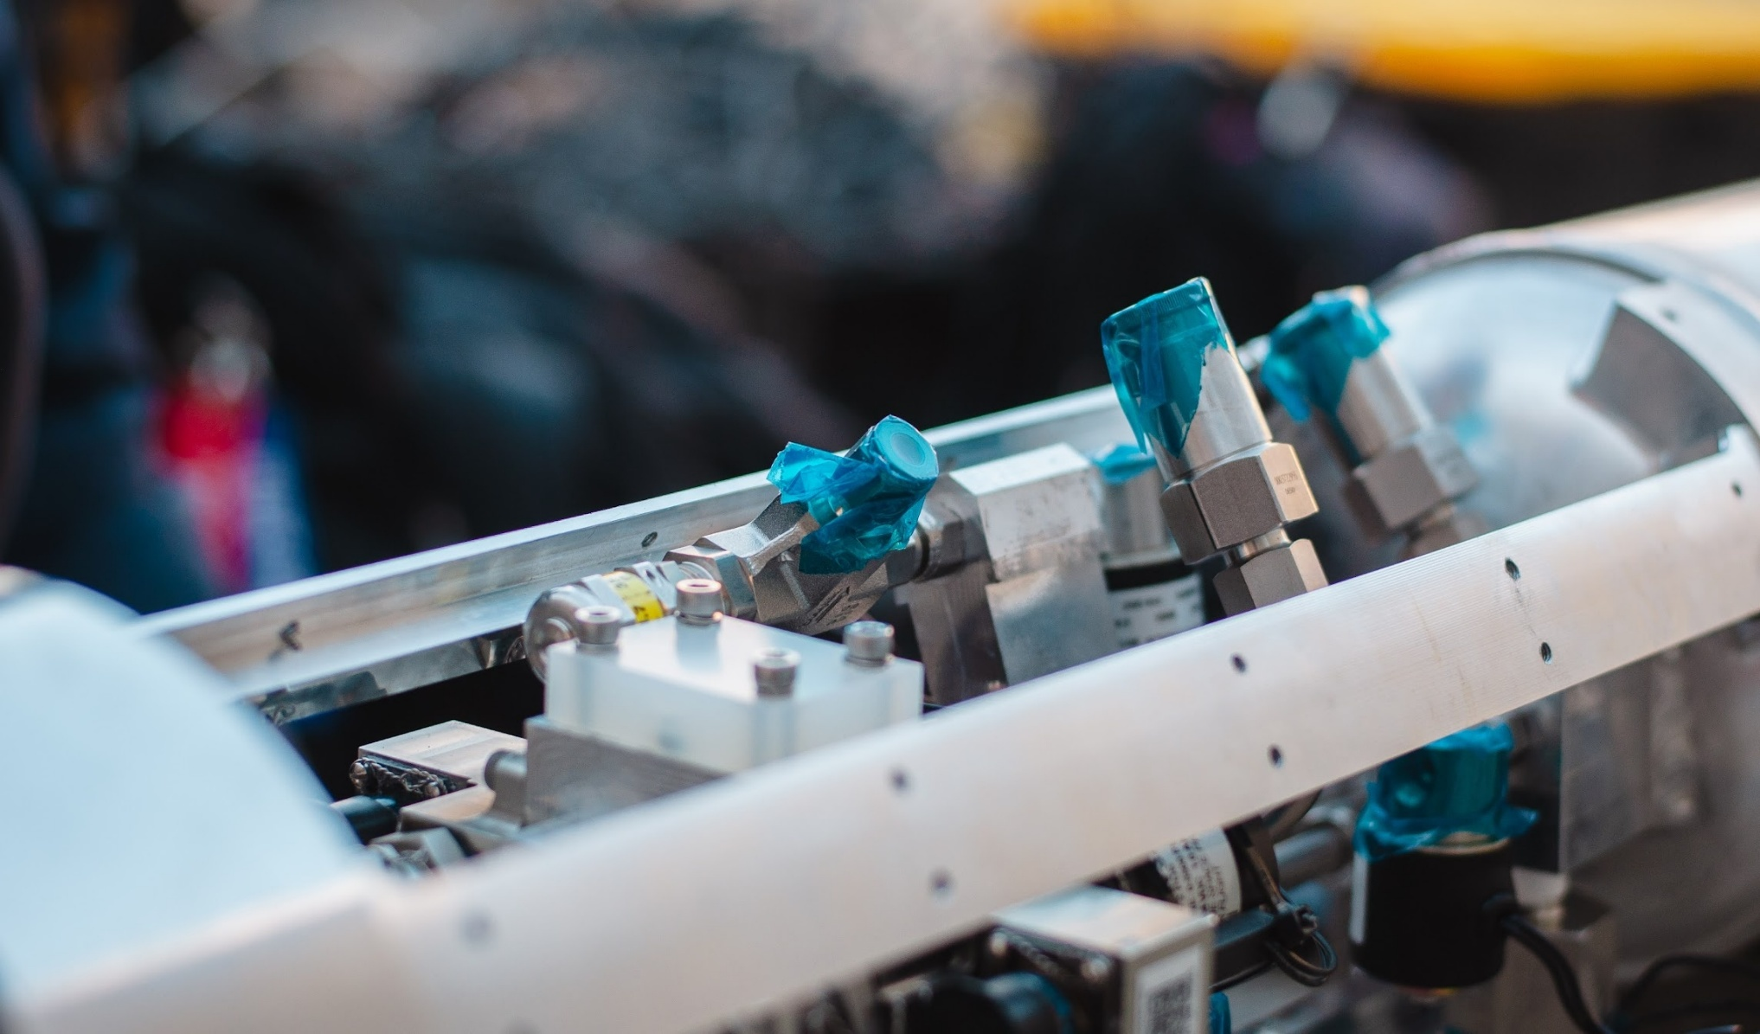
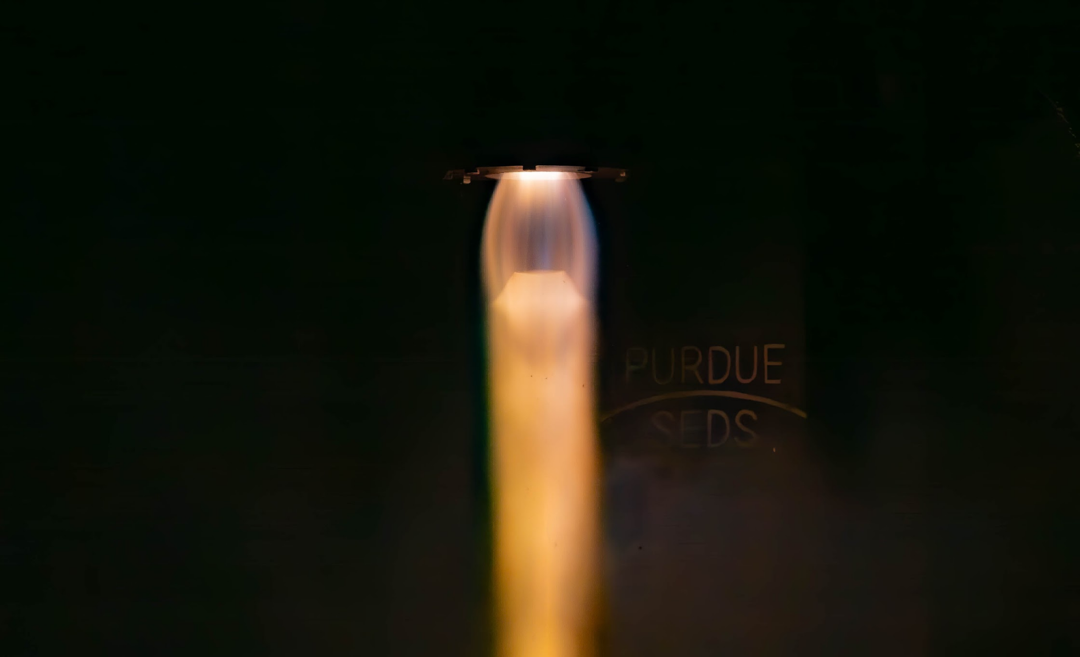
Review
I was the RE for CMS’s Upper Plumbing and took the system through design, build, test, and to full vehicle hotfires
I led testing ops, data reviews and writing procedures for our first pressurized tests
I performed as a Test Operator for integrated vehicle cold flows and hotfires

Slide 16
Why Relativity?
Why do I like Relativity?
Why me?
Doing cool stuff
Reuseable rockets
Methalox engines
Fast-paced, test-driven dev
A team that cares
I don’t have to live in South Texas
I’m a self-starter
I’m extremely motivated
I like to get stuff done
Demonstrated the ability to execute high-ownership projects on tight schedules

Slide 17
Thank You!

Slide 18
Backup Slides

Slide 19
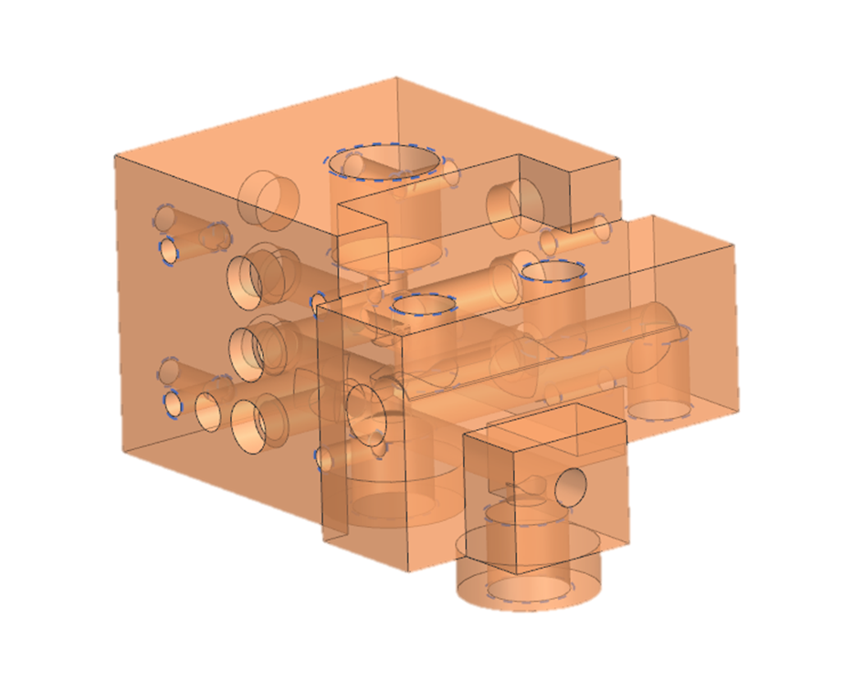
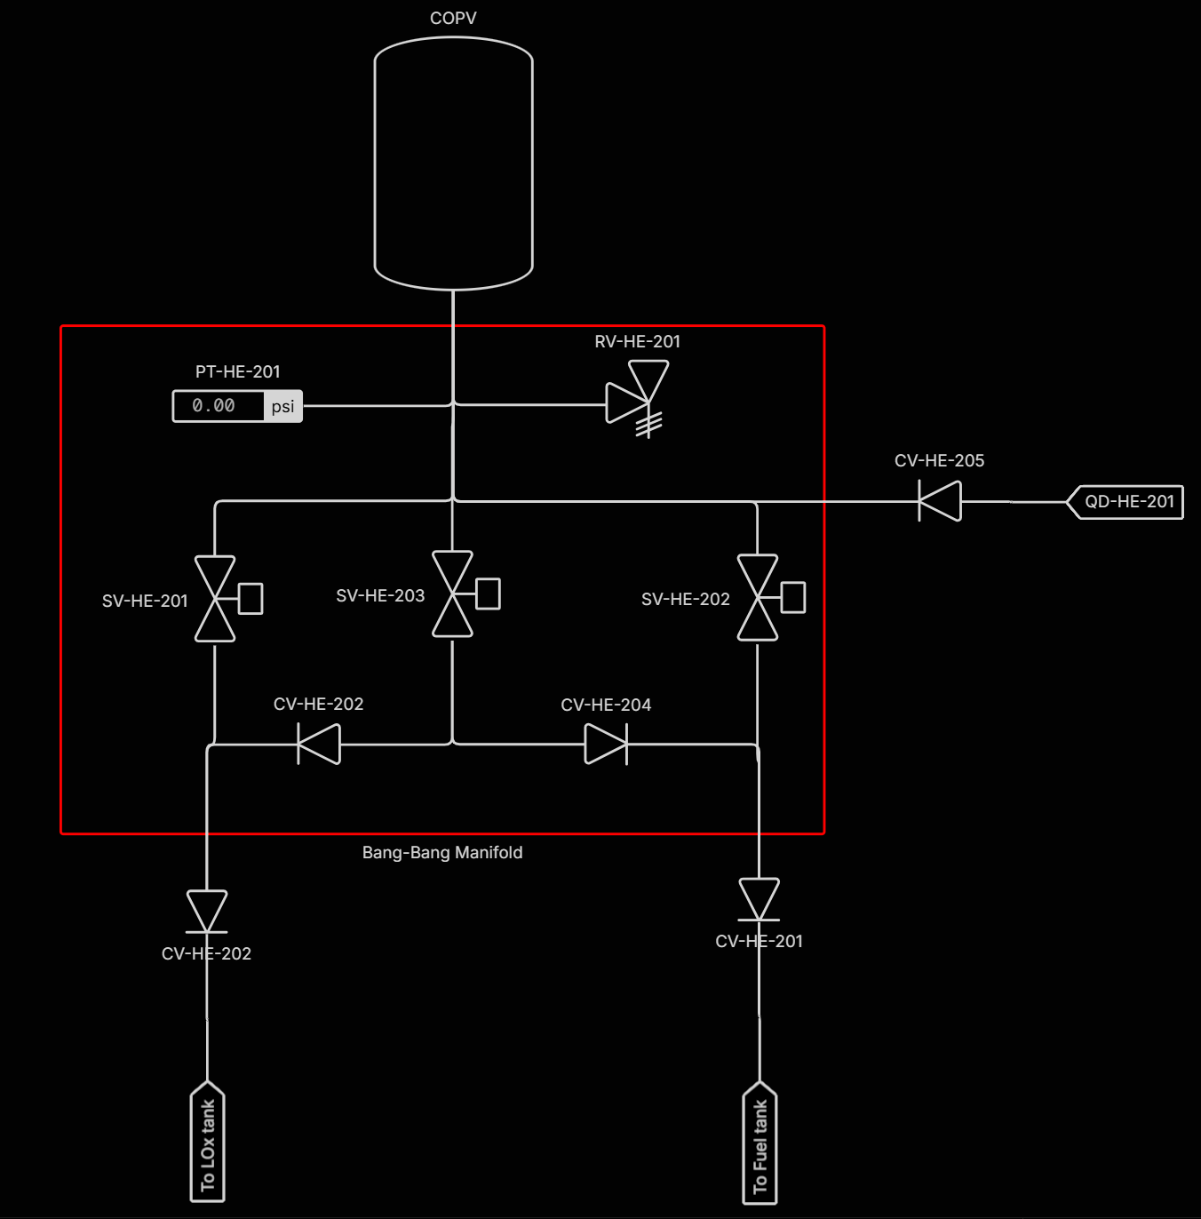
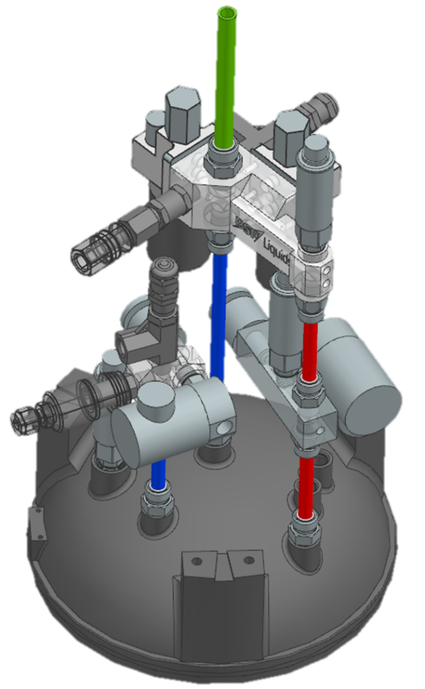
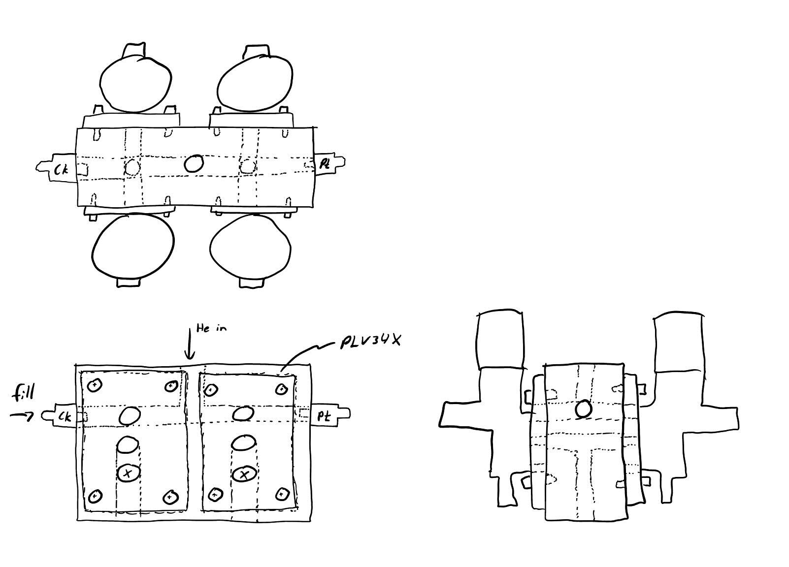
Bang-Bang Manifold
Had four main interfaces:
Helium Fill
COPV
Ox Press
Fuel Press
Everything had to fit within 6.625” diameter (less cover panels)
Had to use min-length tubes to fit size requirements
Dozens of iterations – produced four versions

Slide 20
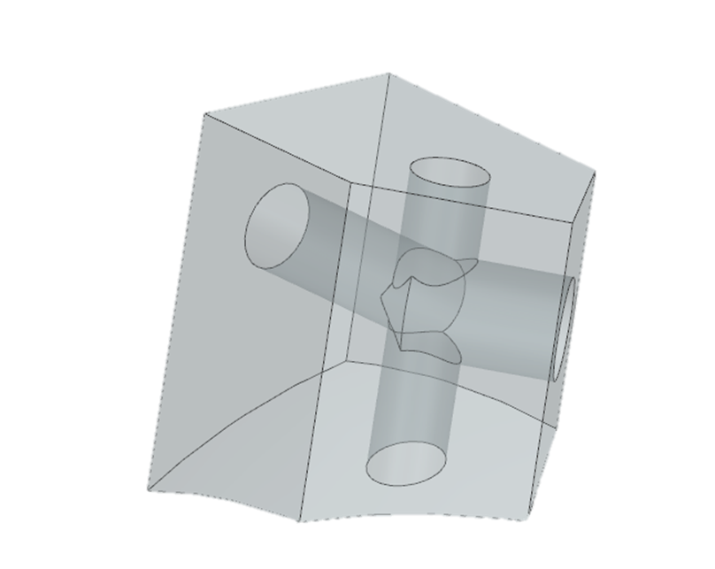
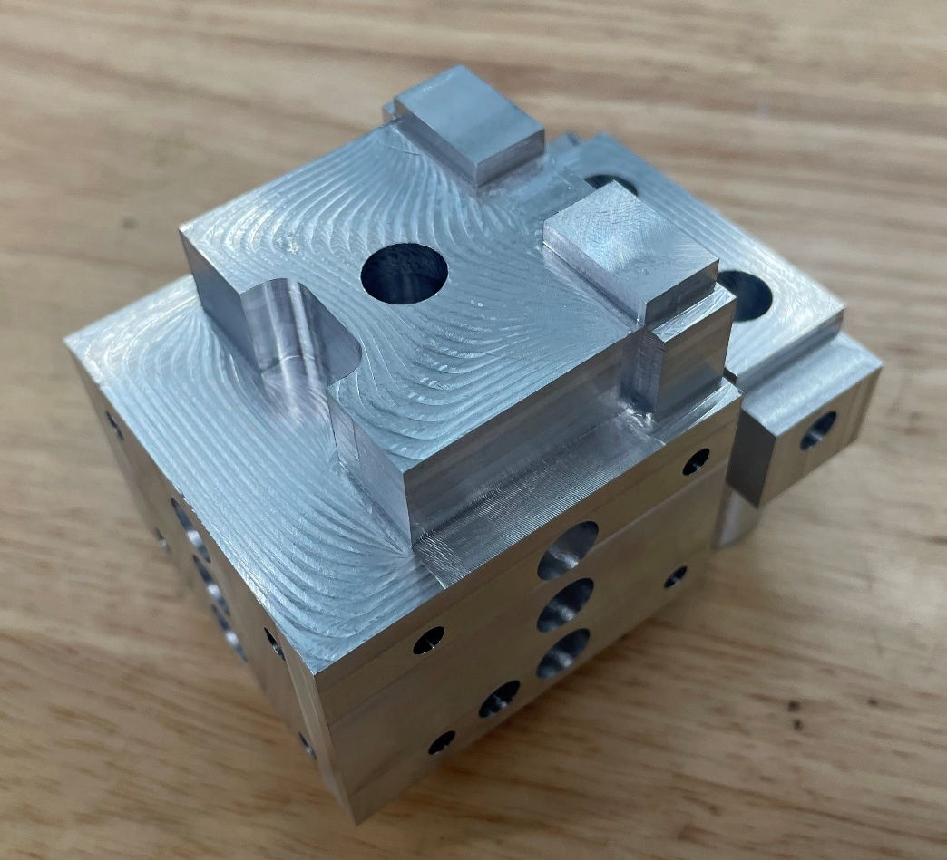
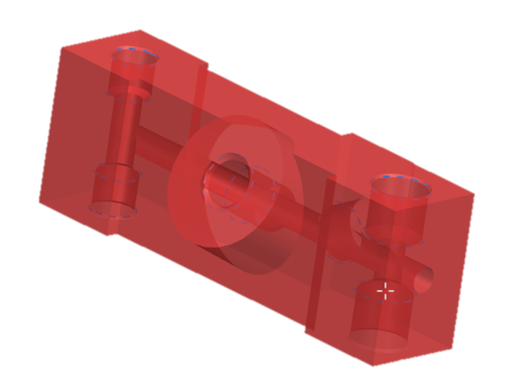
Manufacturing
Driving factor: cost
Didn’t have access to cheap additive manufacturing, so everything had to be manufacturable on a 5-axis CNC
Manifolds milled from Al6061 (for cost + machinability)
Had a single ~5” bore that required a specialized bit

Slide 21
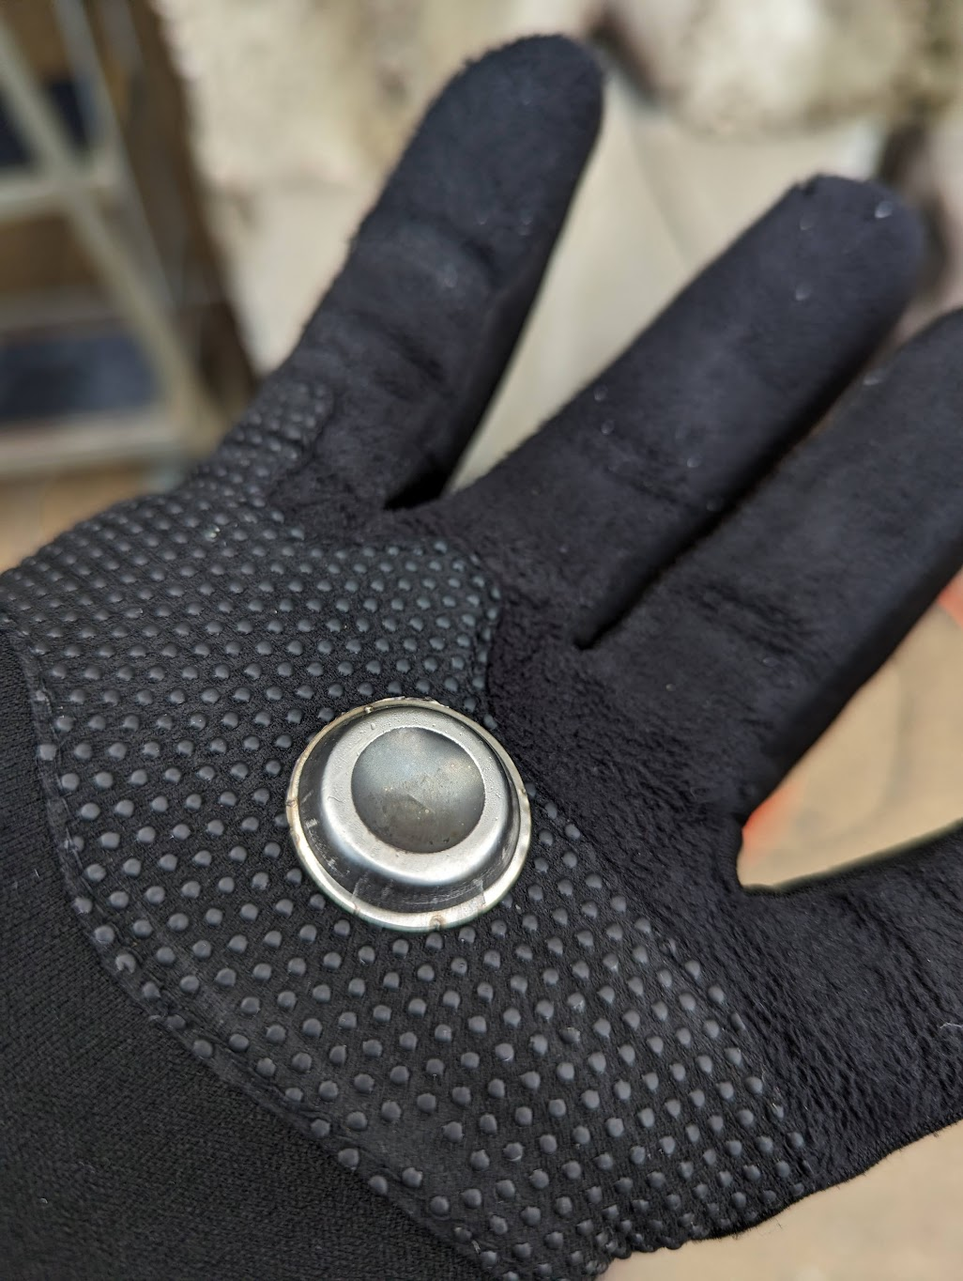
Burst disk FOD impact

Slide 22

Venturi Mass Flow Equation: Sizing Sim
Venturi mass flow: $mdot=c_{d}∗A_{eff}∗\sqrt{2ρ(P_{tank}−P_{vapour})}$

Slide 23
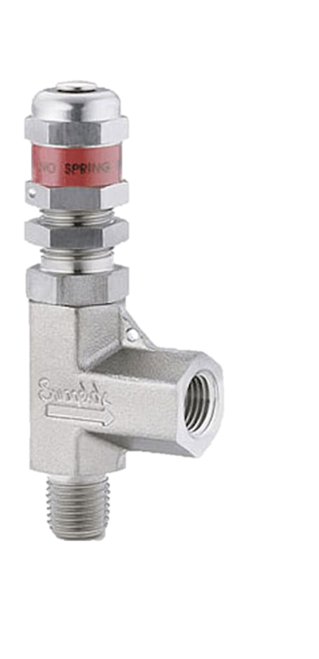
Passive Relief
One ullage burst disk per tank set to burst at proof pressure - 30psi (549 psi)
30psi to account for burst pressure uncertainty
Size for flow rate equal to full open bang-bang valves x 1.5
Relief valve on LOx and LNG tank set to 386 psi
Size for flow rate equal to one full open solenoid

Slide 24
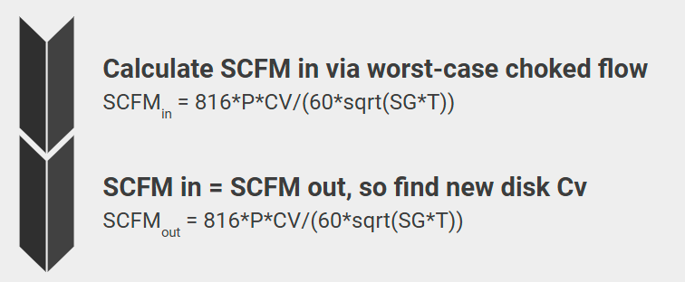
Burst Disk Sizing
Parameter | COPV | Tank
Helium Pressure | 4950 psi | 326 psi
Helium Temp | 70 F | -235 F ()
Max SCFM = 473 SCFM
Parameter | Value
Min Cv | .12

Slide 25
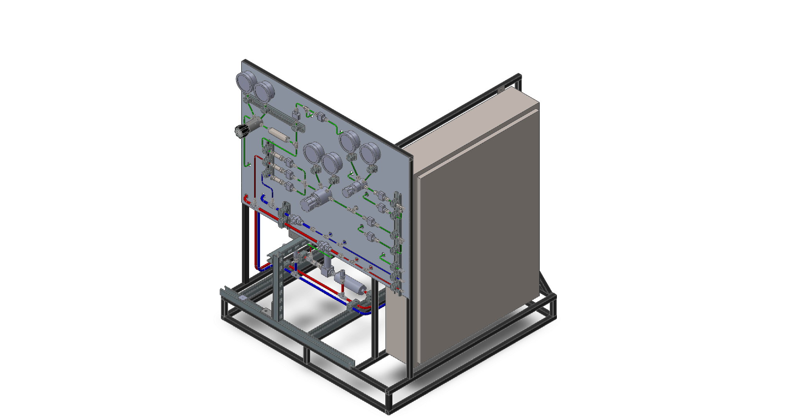
BCLS

